Slide 1
Transforming steering controls to self driving
Week 4 report
Hongshuo Wang
Professor Siu Ling Leung

Slide 2
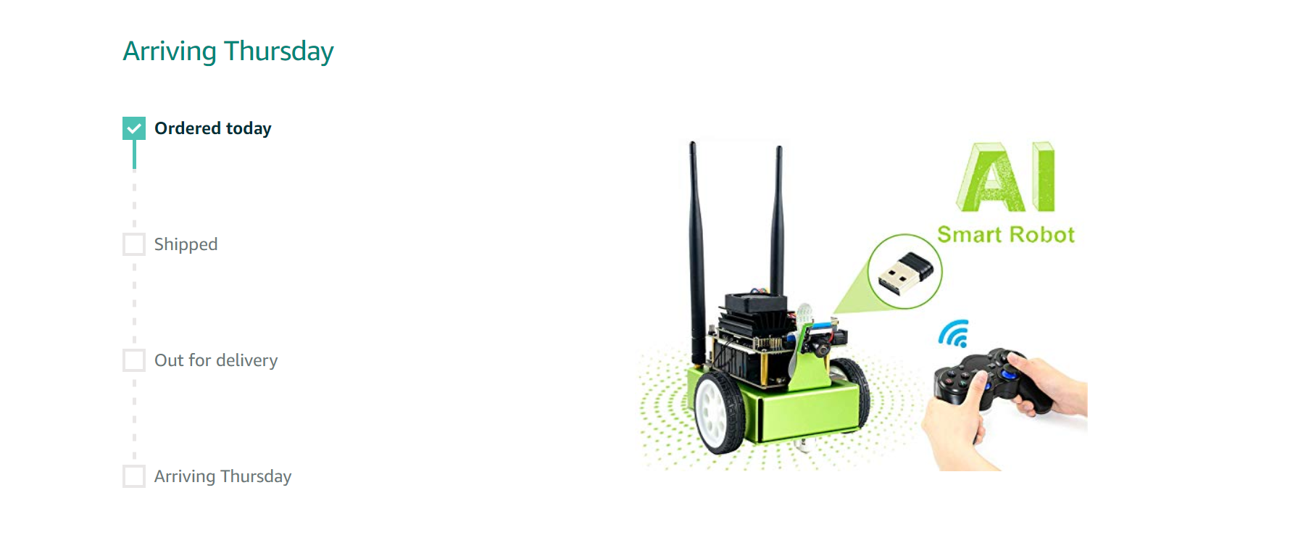
My new car is on the way. It will arrive this Thursday.

Slide 3
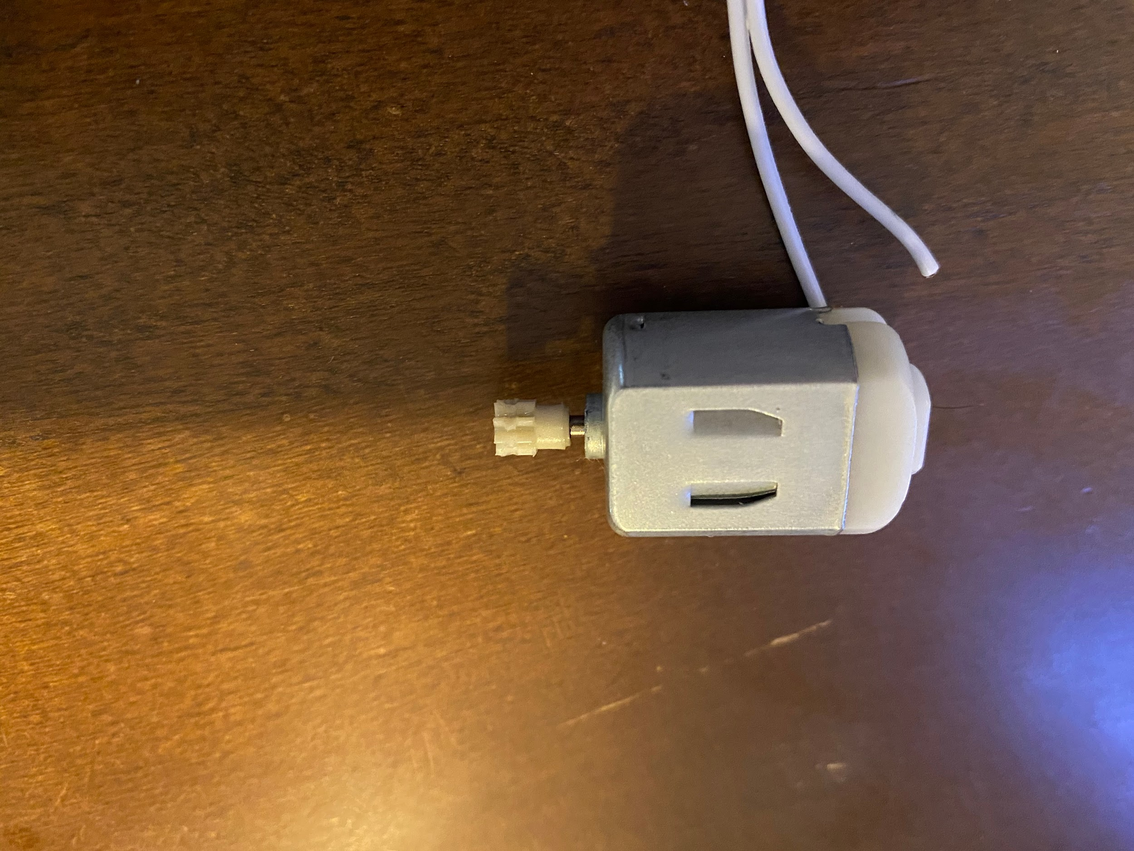
My Car is Broken
My left motor’s gear seems to be worn out during the fast spinning of the car.

Slide 4
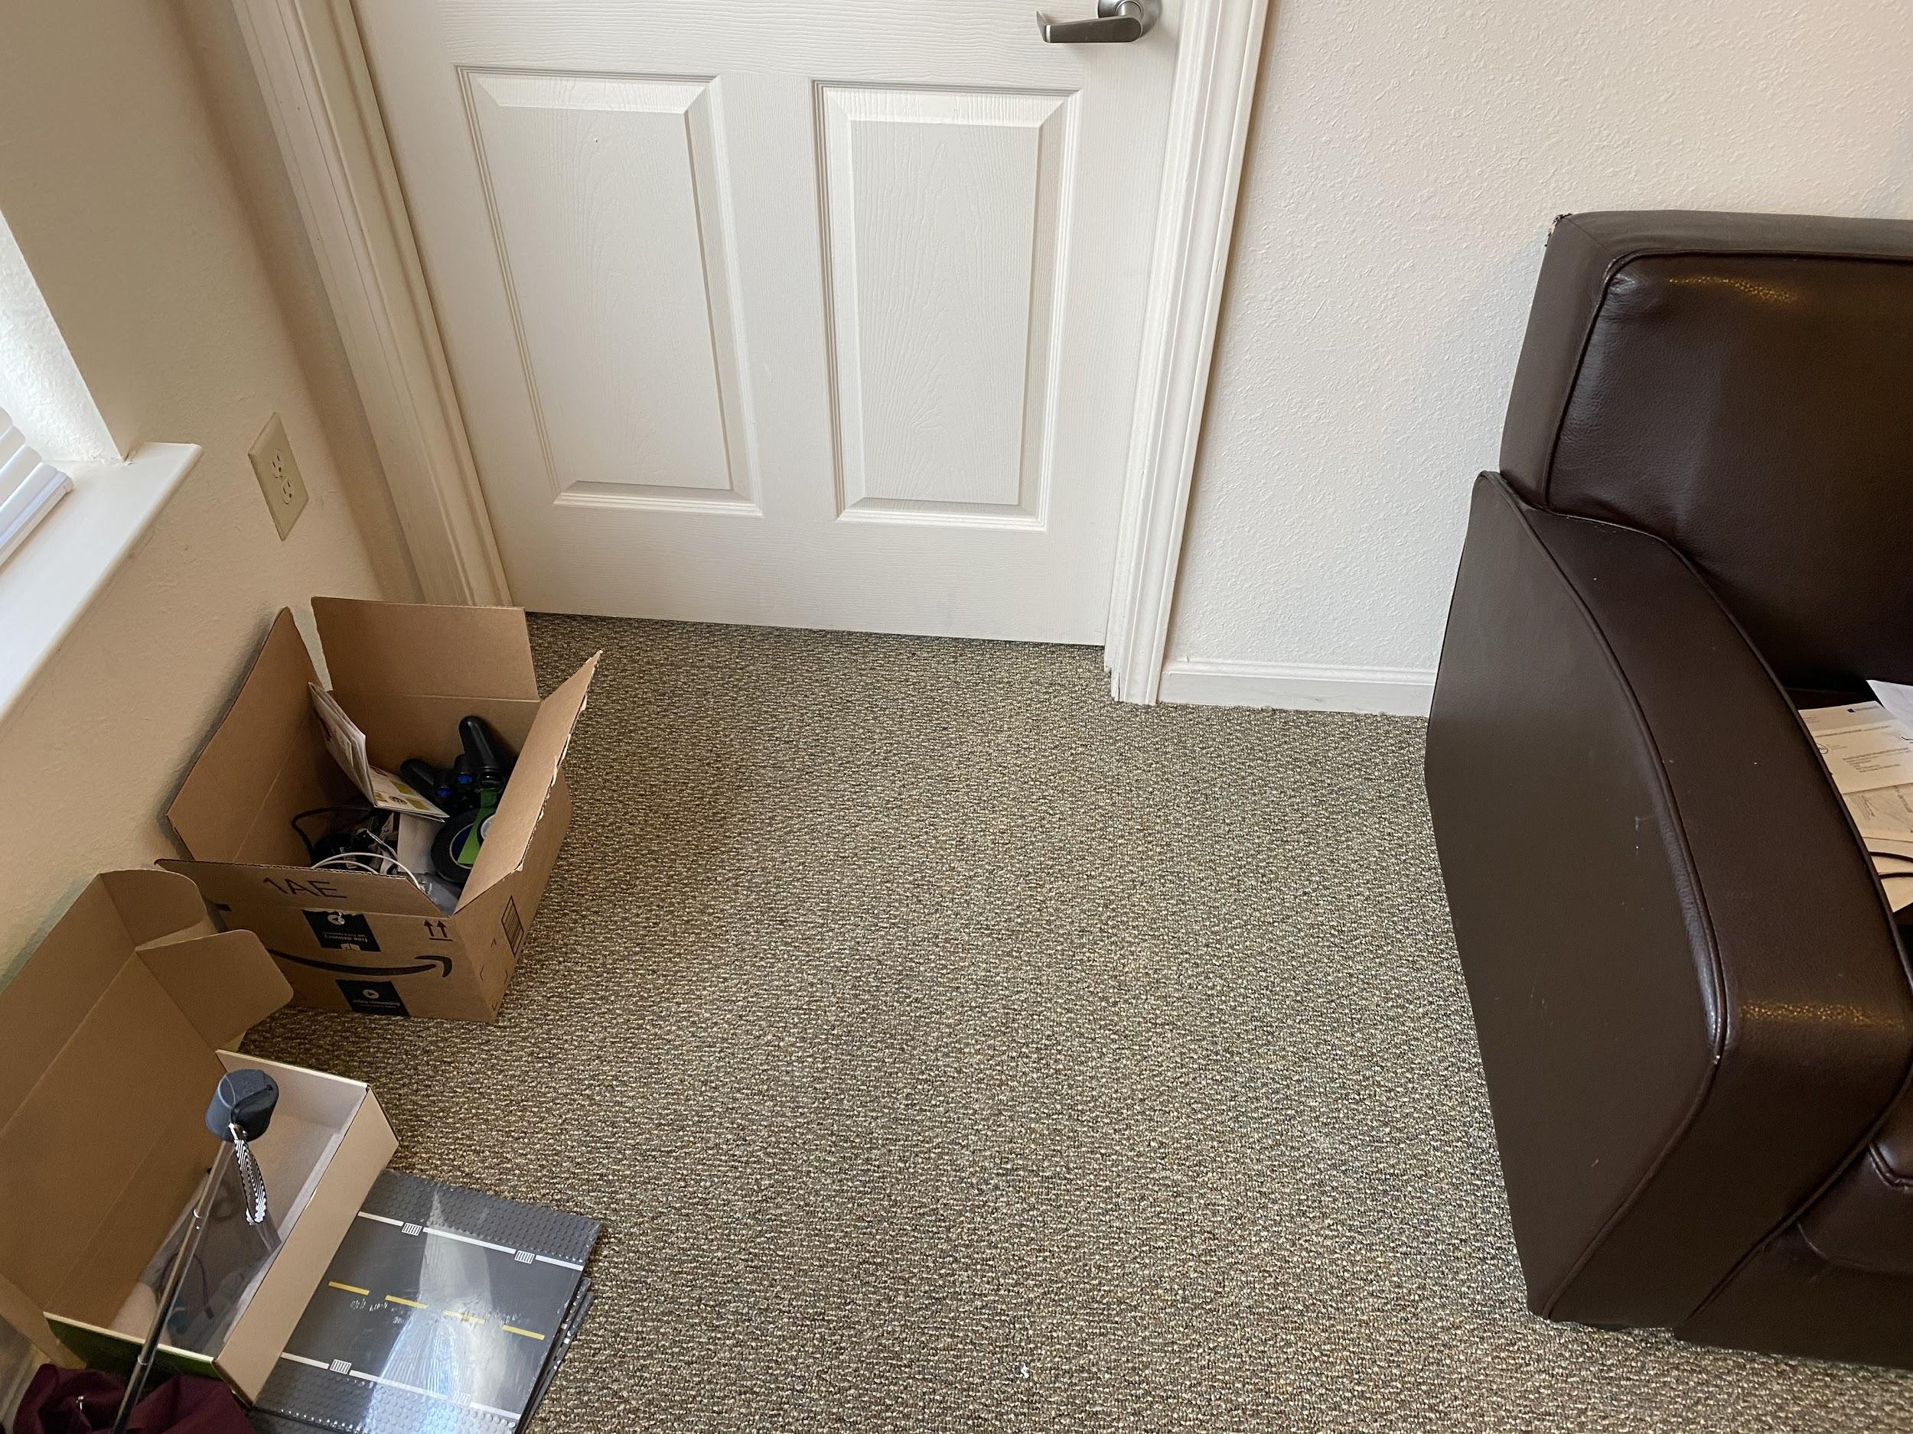
The accident scene

Slide 5
Object Detection （DetectNet）
https://forums.developer.nvidia.com/t/how-to-combine-road-following-and-object-detection/83846
https://github.com/dusty-nv/jetson-inference/blob/master/docs/detectnet-training.md

Slide 6
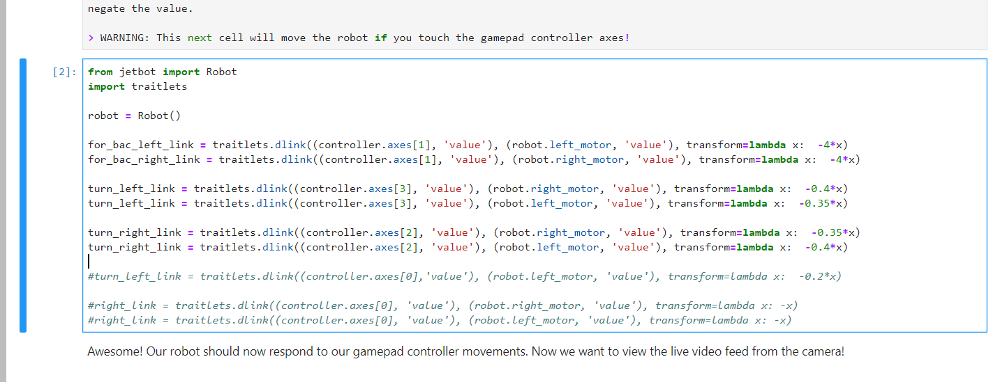
Teleoperation

Slide 7
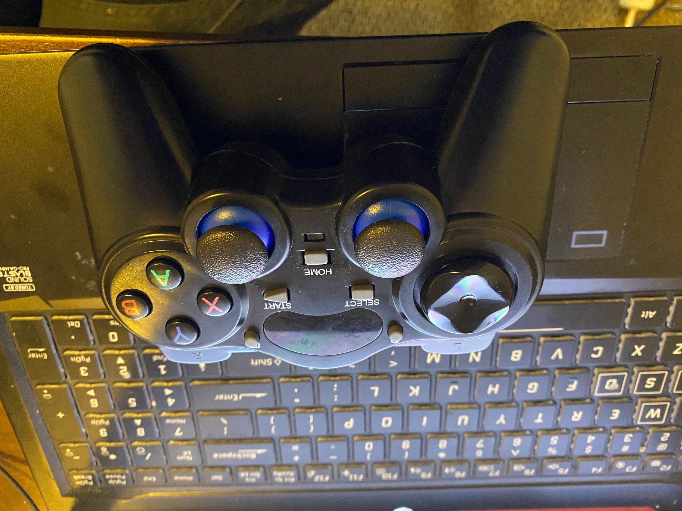
Controller (left joystick (for and back))

